Slide 1


EP8900 Integrated Assesment Modelling
SSP 4 for South Africa

Slide 2
Assumptions for SSP4
1. Overall demand change - adjustement based on projection of GDP in the SSP database for SSP4: results in a decrease in demand
2. R&C demand: the speed of the transition from traditional biomass to electricity is slowed down
3. Rebound effect: as all energy prices become cheaper, the demand for all energgy categories is linearly increased to 15 % in 2070.
4. inv_cost: nuclear, solar and wind costs decreased in order to reach around 50% of SSP2 in 2100, 5% decrease per year
5. fix_cost: nuclear, solar and wind costs decreased in order to reach around 50% of SSP2 in 2100, 5% decrease per year
6.var_cost: biomass_non-commercial decreased at 10% in each year due to social increased acceptance (factor is based on expert knowledge;-) )
7.var_cost: extraction costs for all fuels decreased by 5% in each year due to lower labor costs

Slide 3
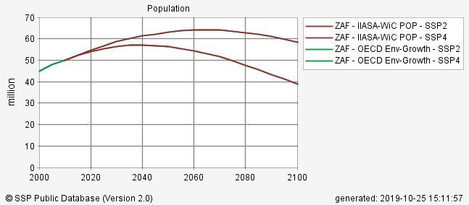
Main drivers
Population is decreasing much faster than in the reference scenario

Slide 4
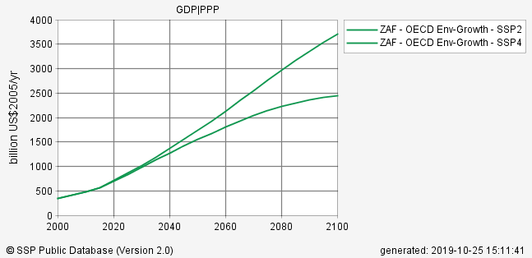
Main drivers
The growth of GDP is lower than in the baseline scenario

Slide 5
Results
GHG Emissions
The GHG emissions are lower compared to SSP2 due to the lower demand

Slide 6
Results
Growth of renewables
Renewables grow faster than in SSP2 after 2030. The rebound effect has little influence

Slide 7
Results
Growth of renewables
Solar is decreasing, while wind is increasing. After 2050?

Slide 8
Results
Nuclear
Less nuclear than in SSP2. More without rebound effect?

Slide 9
Results
Fossil fuel capacity
Fossil capacity increases a lot after 2040.

Slide 10
Results
Coal Extraction
Coal extraction going up, but less than in SSP2. Most of the rebound effect is coal…

Slide 11
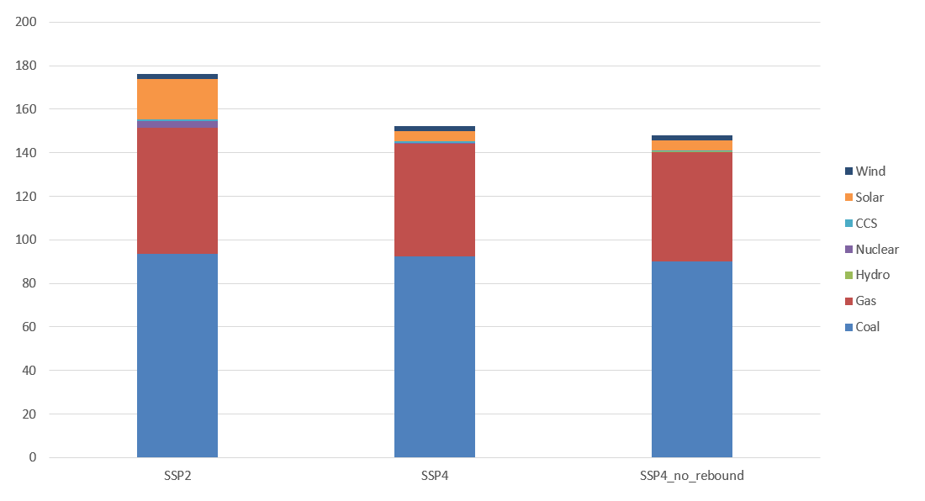
Results
Evolution of the electricity mix
2020

Slide 12
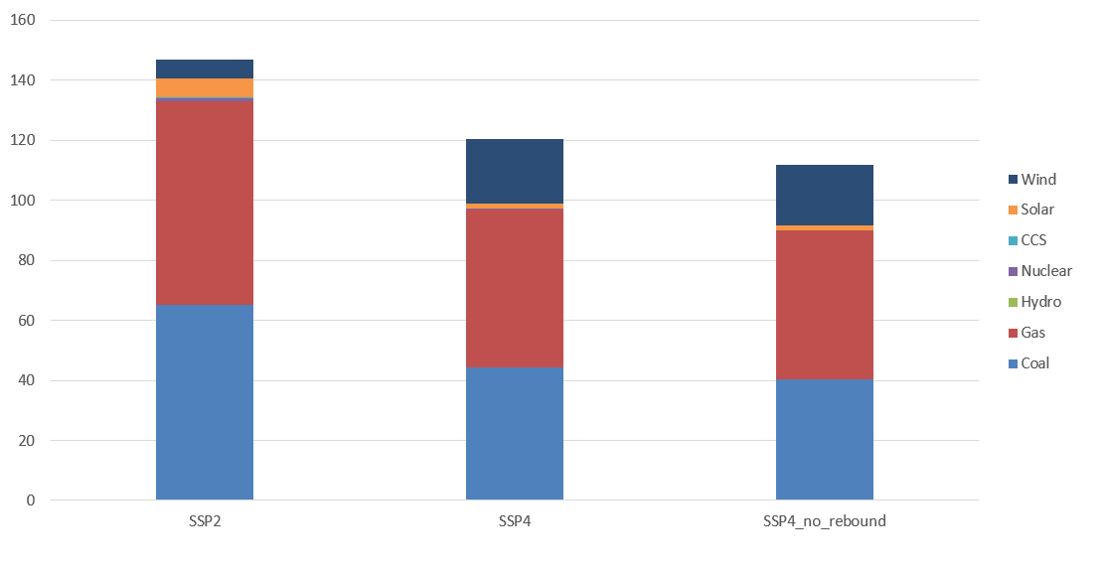
Results
Evolution of the electricity mix
2030

Slide 13
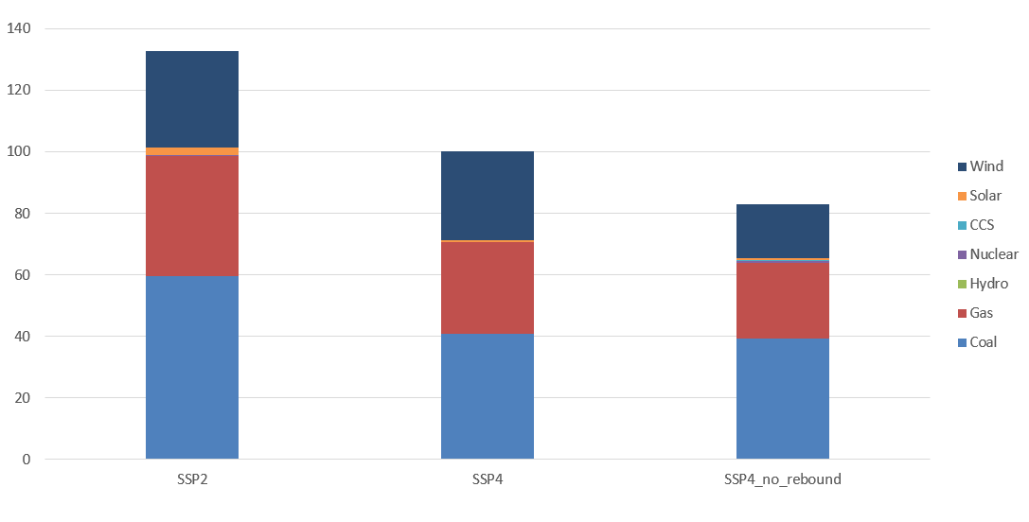
Results
Evolution of the electricity mix
2040

Slide 14
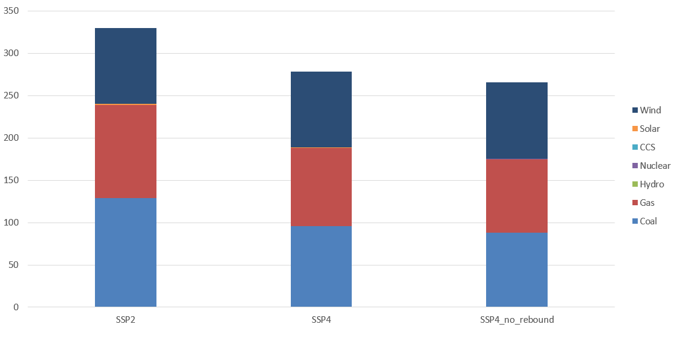
Results
Evolution of the electricity mix
2050

Slide 15
Results
Evolution of the electricity mix
2070

